Slide 1
Big Problem at Big Mountain
To estimate the premium over the average ticket price based on the Big Mountain Resort’s facilities in comparison to market average in order to bring better value.

Slide 2
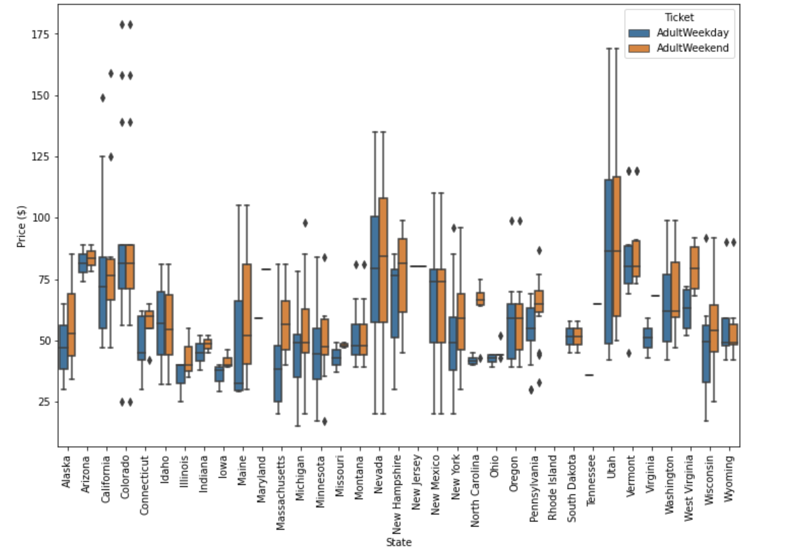
Resorts in USA –vs. Big Mountain

Slide 3
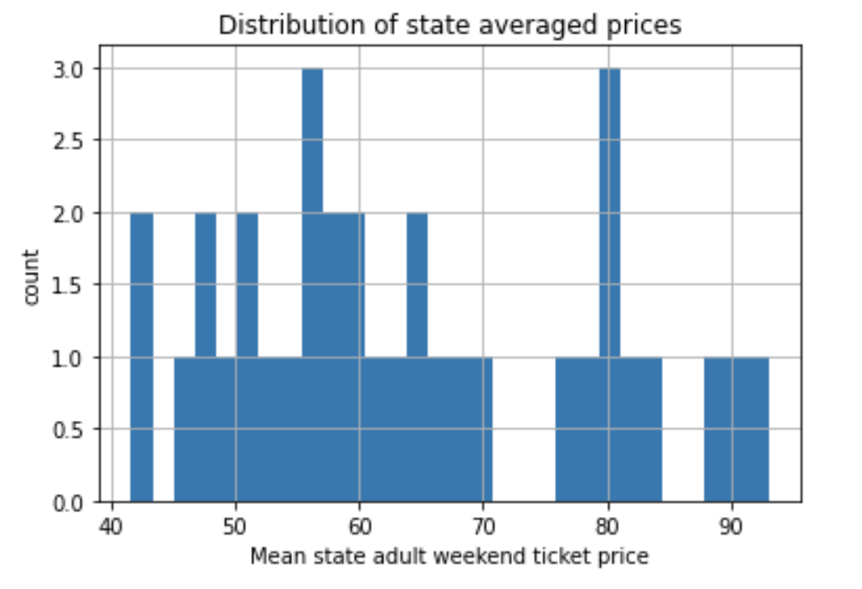
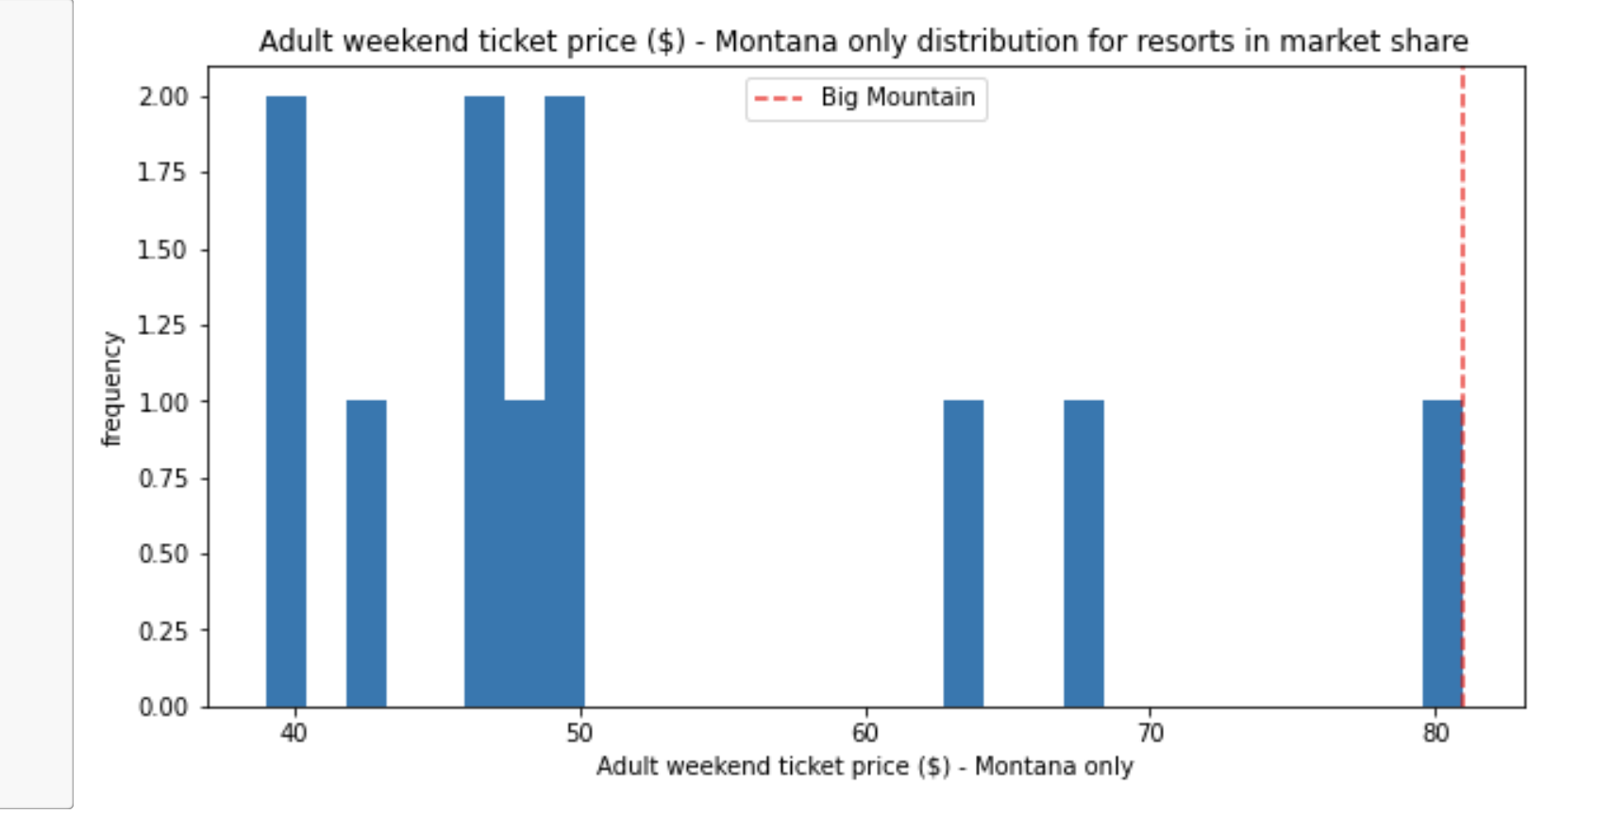
Resorts in Montana vs. Big Mountain

Slide 4
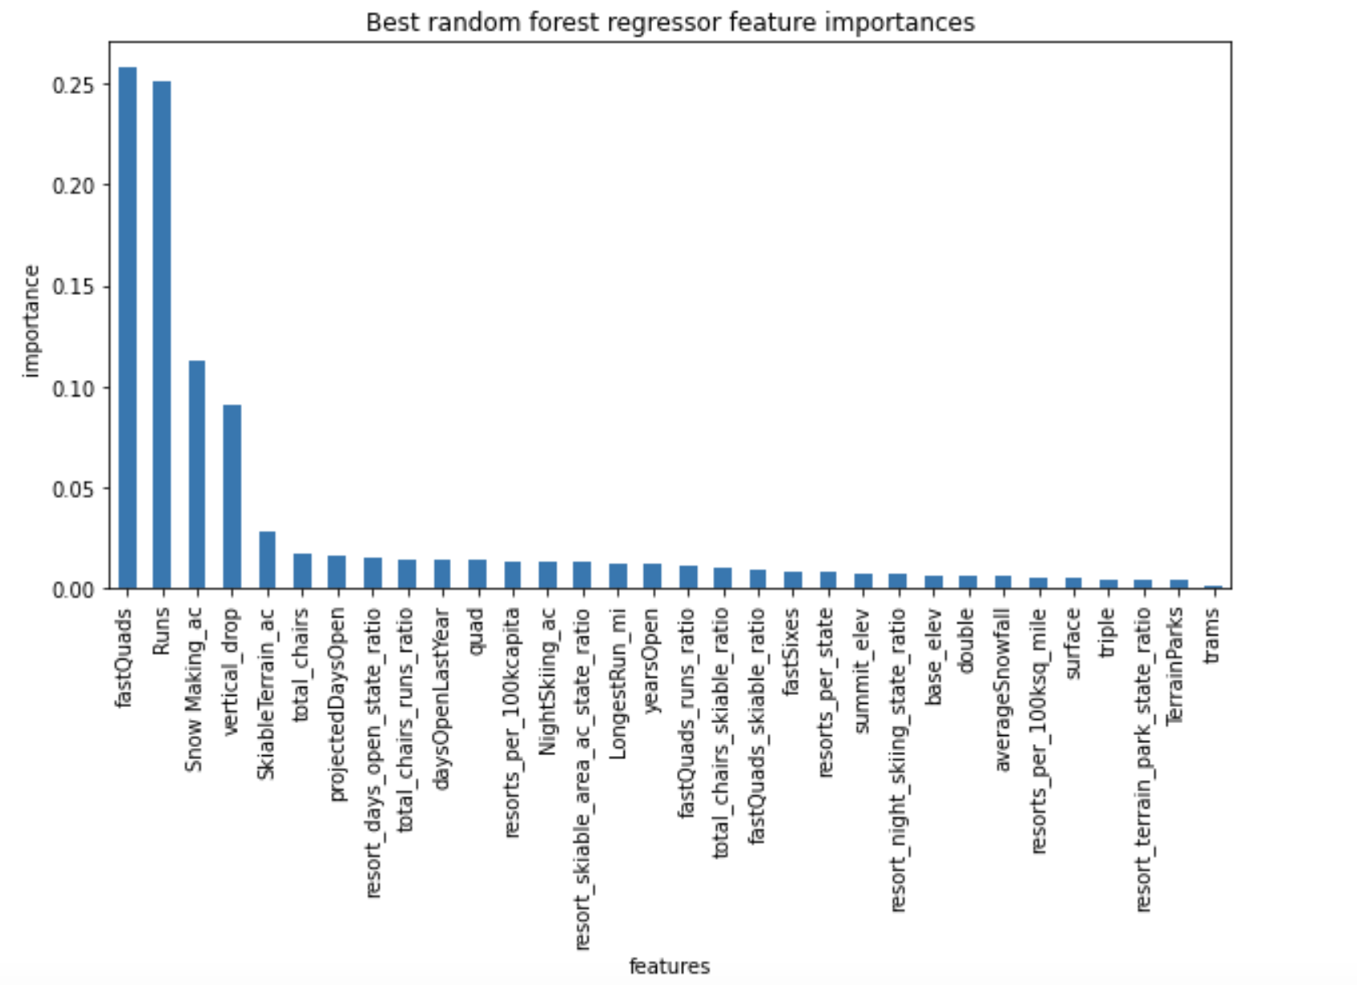
Modelling – Feature Selection

Slide 5
Results
Random Forest Regressor Using Python and Scikitlearn
Mean Absolute Error is 9.5
Predicted AdultWeekend Price is $95
Fine tuning the model by changing scenarios
Revenue Increase by dropping one run and increase the price by $1.99 will bring in revenue of $3,474,638 if the number visitirs stay the same and each visitor buys 5 tickets.
Hence, there is promise to fine tune the model and increase the ticket price to offset operating costs.

